Slide 1


PROJECT PRESENTATION ON
TITLE : PLANT DISEASE DETECTION USING DEEP LEARNING
SEMESTER:VII
GUIDE:Prof.SMITA DESHMUKH
Student Names:
1. TU4F1920037 / A-35 / Satishchandra Boora
2. TU4F1920035 / A-33 /Smitasomya Sah
3. TU4F1920039 / A-37 /Hrishikesh Mandhare
Information Technology Department
Terna Engineering College, Nerul, Navi Mumbai

Slide 2
Table of Contents
Sr.No. Topic Slide No
Introduction……………………………………………………………..3
Literature Survey……………………………………………………….4
Problem Statement……………………………………………………...7
Objective …………………………………………………………….....8
Technological Stack………………………………………………….....9
Proposed Methodology..………………………………………………..10
Implementation …………………………………………………..…….15
Conclusion ……………...........................................................…………20
Reference……………………………………………………………...…21

Slide 3
INTRODUCTION
India being an agro-based economy, farmers experience alot of problem in detecting and preventing diseases in plants. So there is a necessity in detecting diseases in plants which proves to be effective and convenient for Users.
Relying on pure naked-eye observation to detect and classify diseases can be very unprecise .
Therefore in field of agriculture, detection of disease in plants plays an important role. To detect a plant disease in very initial stage, use of disease detection technique is beneficial.
So Deep learning and neural networks can be used to get more accurate result.

Slide 4
Literature Review
Title of paper | Method used | Disadvantages
Remote area Plant Disease Detection using Image Processing [Navdeep Sharma IOSR journal] 2018 | The method involves collecting digital images of healthy and affected plants and then separating the RGB components of these images. The CCM (color co-occurrence matrix) methodology is used for texture analysis, and K-means clustering is used for image segmentation. | Limited scope Dependence on image quality Complexity Limited feature set

Slide 5
Literature Review
Title of paper | Method used | Disadvantages
Plant Disease Detection using Image Processing[Mr.V Suresh, D Gopinath IJERT journal] 2020 | It has the algorithms and models to recognize species and diseases in the crop leaves by using Convolutional Neural Network. | Limitations in image quality Variability in plant appearance Sensitivity to changes in environmental conditions Complexity of the algorithms

Slide 6
Literature Review
Title of paper | Method used | Disadvantages
An Overview of the Research on Plant Leaves Disease detection using Image Processing Techniques [Ms. Kiran R. Gavhale,Prof. Ujwalla Gawande IOSR journal] 2014 | summarizes image processing techniques for several plant species that have been used for recognizing plant diseases major techniques for detection of plant diseases are: BPNN, SVM, K-means clustering, and SGDM. | effect of background data in the resulting image. automation of the technique for continuous automated monitoring of plant leaf diseases under real world field conditions optimization of the technique for a specific plant

Slide 7
Literature Review
Title of paper | Method used | Disadvantages
Plant Disease Detection Using Machine Learning [Shima Ramesh, Mr. Ramachandra Hebbar] | 1. Hu moments 2. Haralick texture 3. Color Histogram | limited accuracy and Scope small dataset

Slide 8
Literature Review
Title of paper | Method used | Disadvantages
Plant Leaf Disease Detection and Classification based on CNN with LVQ Algorithm [Melike Sardogan, Adem Tuncer] IEEE Xplore 2018 | LEARNING VECTOR QUANTIZATION (neural network) | similarity can cause some leaves to be folded into to wrong classest.

Slide 9
Problem Statement
India is renowned as a nation of farmers, and there are acres dedicated to agriculture. The plants become sick because of a variety of circumstances, including temperature, pollution, pests, and many more. Sometimes these infected plants are not visible enough to determine the type of illness that it has produced. This results in mass deduction of food production.
Pure naked-eye observation to detect and classify diseases can be very unprecise. Without proper identification of the disease , disease control measures can be a waste of time and money and can lead to further plant losses. Proper disease diagnosis is therefore vital.

Slide 10
Objectives
To detect the crop disease using Convolutional Neural Network algorithm.
To give right knowledge to the users about which disease the crop has using the image classification.
To help predict disease and display the actions to be taken at the right time.
To give right knowledge to the users about which crop to sow and which fertilizer to use in their field based on the soil data using Machine Learning.

Slide 11
Technological Stack
Platform- Jupyter Notebook
FrontEnd - HTML,CSS
BackEnd - Flask(Python)
Technology - Deep Learning (TensorFlow-Keras)

Slide 12
Proposed Methodology
Image Acquisition-
We use PlantDisease Dataset. The dataset consists of 87,900 healthy and unhealthy leaf images divided into 38 categories by species and disease. A analysis of more than 50,000 images of plant leaves with distributed labels from 38 classes will be carried out to predict the class of diseases.
2) Cleaning and Image restoration –
The data processing and image augmentation are done using the Keras deep-learning framework. Image augmentation artificially creates the training images through different ways of processing.(random rotation, shift, shear, flips.)

Slide 13
Proposed Methodology
Segmentation -
One of the most difficult steps of image processing is segmentation. It involves splitting an image into its constituent parts or objects. The main goal of image segmentation is to obtain the region of interest (ROI) of the diseased plant leaf from image.
4) Feature Extraction -
Once the image segmentation is completed, the segmented image features would be extracted to train the classifier. The algorithm that we will be using is CNN to perform feature extraction.

Slide 14
Proposed Methodology
5) Classification–
ater, the features that were extracted from the previous stage will fed to the SVM classifier as inputs and it maps these features into high-dimensional feature spaces using its kernel function.
6) Treatment -
Based on the detected disease we will propose a solution to the disease also we will provide the cause of disease.

Slide 15
Block Diagram
Pre - Processing
Feature Extraction
System
Dataset Images
CNN Classification
Unhealthy
Healthy
Detected Disease
Treatment

Slide 16

Convolutional Neural Network

Slide 17
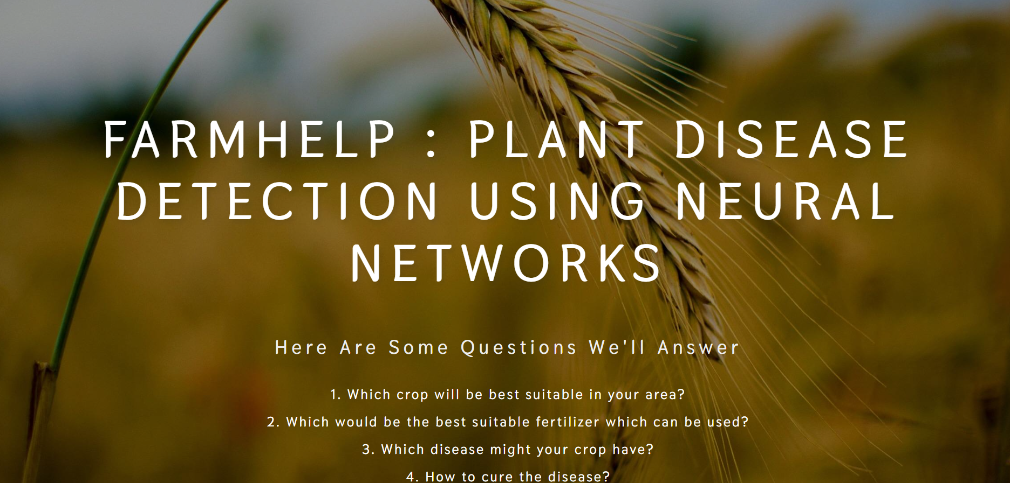
Implementation

Slide 18
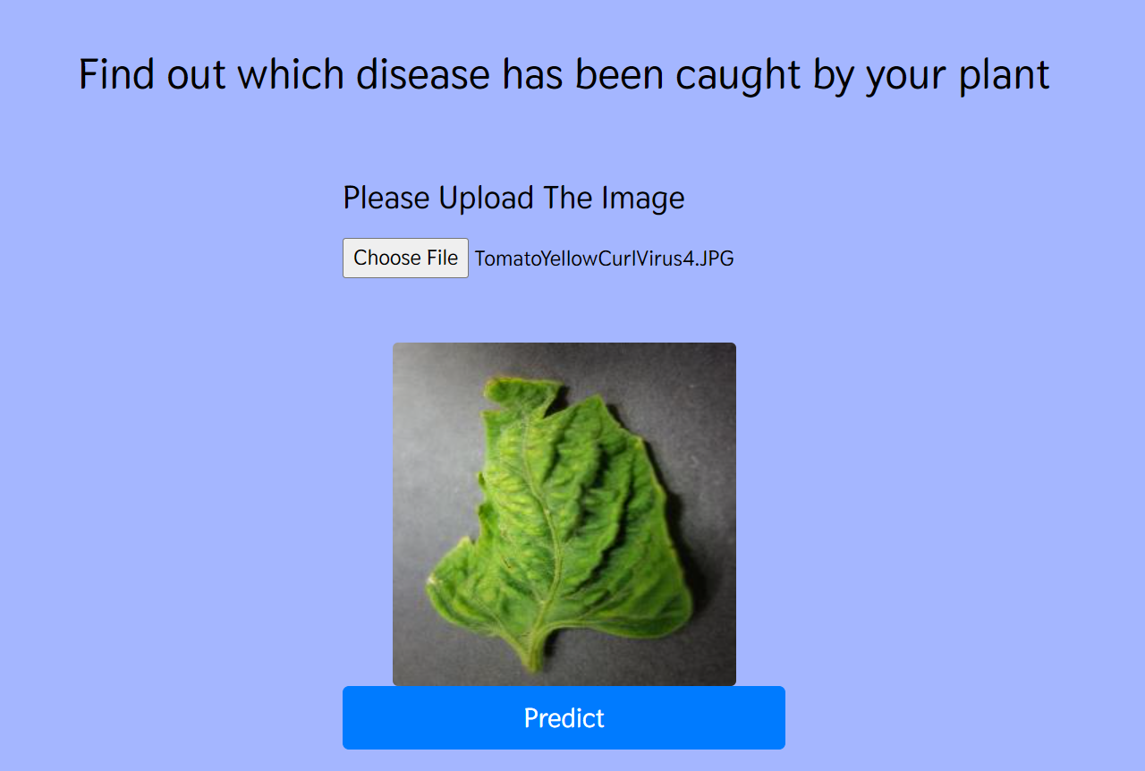
Implementation

Slide 19
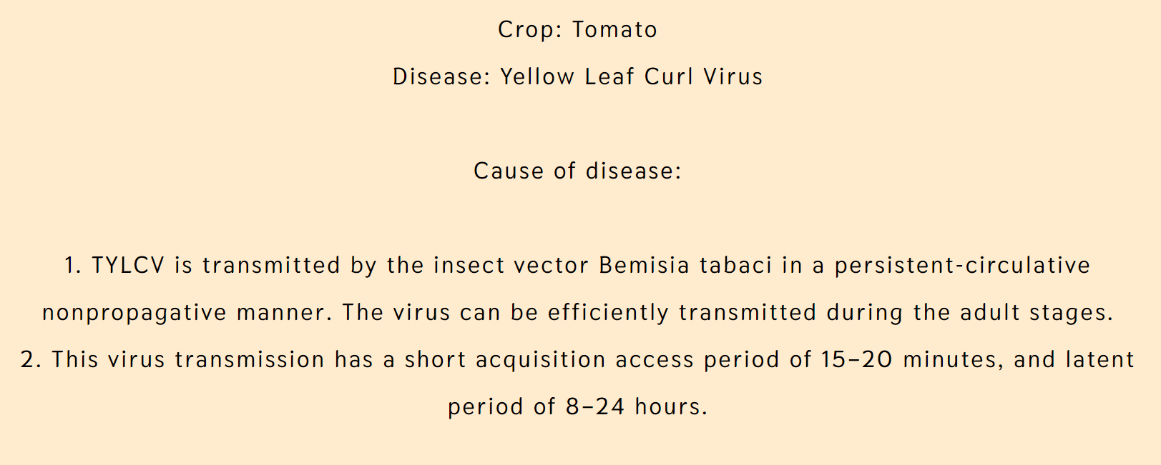
Implementation

Slide 20
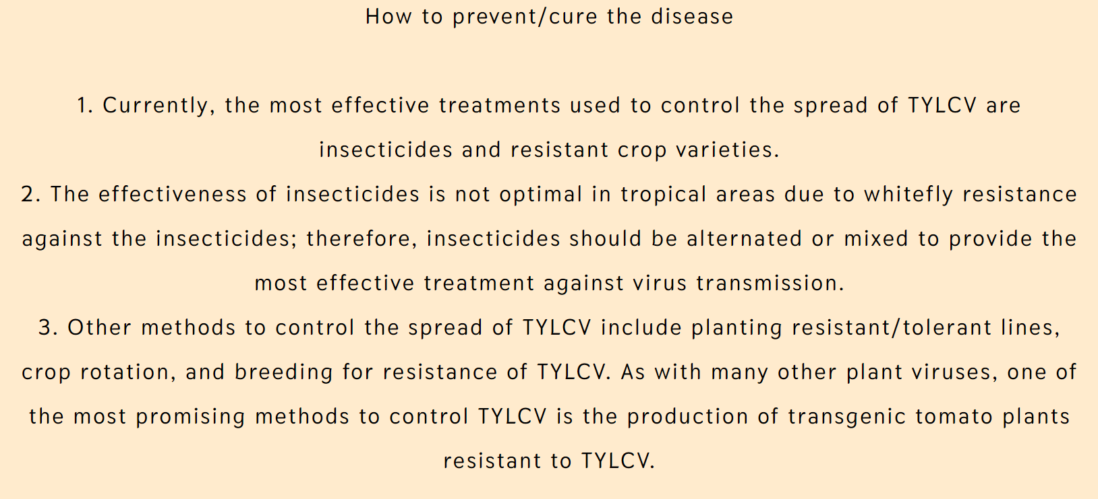
Implementation

Slide 21
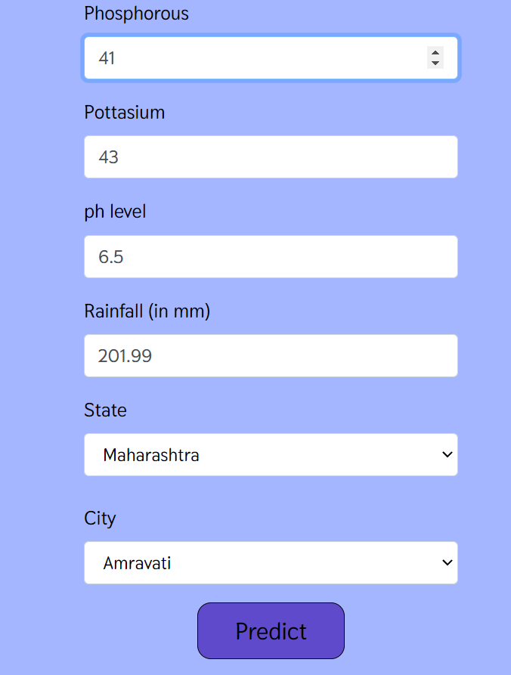
Implementation

Slide 22


Implementation

Slide 23
Conclusion
Plant diseases have been a significant concern in agriculture for years. Precision agriculture has enabled early disease detection and the minimization of losses through optimal decisions based on the results of DeepLearning methods. DL provide solutions with highly-accurate results that enables fast processing thus helps users to detect disease and provide treatment succesfully.

Slide 24
References
[1]Marzougui, F., Elleuch, M., Kherallah, M. (2020). A Deep CNN Approach for Plant Disease Detection. 2020 21st Inter- national Arab Conference on Information Technology (ACIT). doi:10.1109/acit50332.2020.9300072
[2]Liu, J., Wang, X. Plant diseases and pests detection based on deep learning: a review. Plant Methods 17, 22 (2021). https://doi.org/10.1186/s13007-021-00722-9
[3]Pandian, J.A.; Kumar, V.D.; Geman, O.; Hnatiuc, M.; Arif, M.; Kanchanadevi, K. Plant Disease Detection Using Deep Convolutional Neural Network. Appl. Sci. 2022, 12, 6982. https://doi.org/10.3390/ app12146982
[4]Saleem, M.H.; Potgieter, J.; Arif, K.M. Plant Disease Detec- tion and Classification by Deep Learning. PlanNetworks, 8, 468. https://doi.org/10.3390/plants8110468

Slide 25
References
[5]Srivastava, Prakanshu / Mishra, Kritika / Awasthi, Vibhav / Sahu, Vivek
/ Pal, Pawan Kumar. (2021). PLANT DISEASE DETECTION USING
CONVOLUTIONAL NEURAL NETWORK. International Journal of Advanced Research. 09.691-698.10.21474/IJAR01/12346.
[6]L. Li, S. Zhang and B. Wan,g, ”Plant Disease Detection and Chasi- fication by Deep Learning—A Review,” in IEEE Access, vol. 9, pp. 56683-56698, 2021, doi: 10.1109/ACCESS.2021.3069646
[7]A. KP and J. Anitha, ”Plant disease classification using deep learning,” 2021 3rd International Conferethe nce on Signtypesrocessing and Com- munithe cation (ICPSC), Coimthe batore, India, 2021, pp. 407-411, doi: 10.1109/ICSPC51sizes2021.9451696.
[8]S. M. Omer, K. Z. Ghafoor, and S. K. Askar, “Plant Disease Diag- nosing Based on Deep Learning Techniques: A Survey and Research Challenges”, ARO, vol. 11, no. 1, pp. 38-47, Feb. 2023.

